Slide 1
New Hampshire
Liquor Commission
Retail Outlet IT Equipment Support
NHLC RFP# 2025-06
July 10, 2025

Slide 2
Agenda
Introduction of NHLC Team
NHLC Overview
General Scope of RFP
2024 Support Calls
Key points of the RFP and Response
Important Procedural Items
Vendor Questions

Slide 3
NHLC Team
Patricia Peters- Director of Administration
Stephanie Bosstick – NHLC Chief Legal Counsel
Steve Gagnon – Chief Systems Officer
Dorinda Lacey– Help Desk Supervisor
Mike Therrien – DoIT Lead
Jim Cordio– DoIT Technical Support Specialist
Janet Donnelly – RFP Point of Contact

Slide 4
New Hampshire Liquor Commission Overview

Slide 5
Organizational Structure
Office of the Commissioners
Chairman &
Deputy Commissioner
Division of Enforcement
Division of Administration
Division of Marketing & Merchandising
Enforcement
Licensing
Education
Grants
Finance
Human Resources
Audit / Inventory Control
Information Technology
Legal
Marketing
Outlet/Store Operations
Advertising
Warehousing

Slide 6
Control State
NH is one of 17 Control States
The state directly controls the distribution and regulation of alcoholic beverages.
Beer Tax is collected from the distributor
NHLC is the wholesaler for Spirits and Wine
Sale to the Public
Spirits and wine are sold at 65 NHLC operated outlets and 3 agency stores for off-premise consumption.
Spirits, wine, and beer are sold at on-premise licensees (Restaurants & Bars) for consumption on site.
Wine and beer are sold at off-premise licensees (Grocery and convenience stores) for off-premise consumption.

Slide 7
Business Partners
Manufacturers
Brokers
On-Premise Licensees (Restaurants & Taverns)
Off-Premise Licensees (Grocery Stores & Convenience Stores – Beer & Wine)
3 Agency Stores
Logistics – DHL

Slide 8
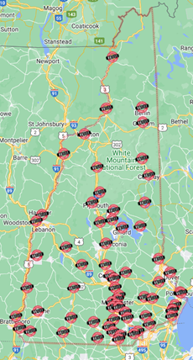
Outlet Locations
65 Retail Outlet Locations
Notes:
REMOVE?

Slide 9
Alcohol Net Profit History
Total Net Profit 1935 to 2023*
$4,520,865,050
*FY23 unaudited
Notes:
Page 25 is our net profit history, the first chart is the growth since the Commission started in 1935.
In the Commission’s 88 years of operations it has earned over $4.3 billion in net profit.
The other chart is the last 10 years of our annual Net Profit from FY13 to FY22 so you can see the consistent trend.
FY14 to 16 $3 to 4M growth; FY17 to 20 relatively flat; FY21 growth $28M

Slide 10
IT Environment

Slide 11
System Partners
DHL – Manhattan System
Evenica – eCommerce site development and operation
System Automation – Div of Enforcement System
DoIT – Network and Data Center support
DAS – NHFirst – State Financial system
Chase – NH’s Acquiring Bank (transitioning to BoA)
New West – D365 Payment connector
GPI – Payment Gateway
GiveX – Gift Card operations
VusionGroup – Electronic shelf tags at 4 stores

Slide 12
NextGen System Environment
NextGen
Dynamics 365 Finance
Dynamics 365 Commerce
Dynamics 365 Supply Chain Management
Store Commerce app for Windows
Store Commerce for mobile

Slide 13
Retail Locations IT Environment
Lanes
All-In-One PC model
HP RP915 “Gen 2” (prevalent)
HP Engage One Pro “Gen 3”
HP Standard Duty Cash Drawer
HP POS Keyboard
Epson TM-T88V Receipt Printer
Barcode Scanners
Code CR5025 (prevalent)
Code CR5210
Verifone M400 Merchant Card Terminals
Netgear GS105NA switch (prevalent)
Cisco IP Phone 7841
Lane 1
UPS Tripp-Lite Smart1500MXLN

Slide 14
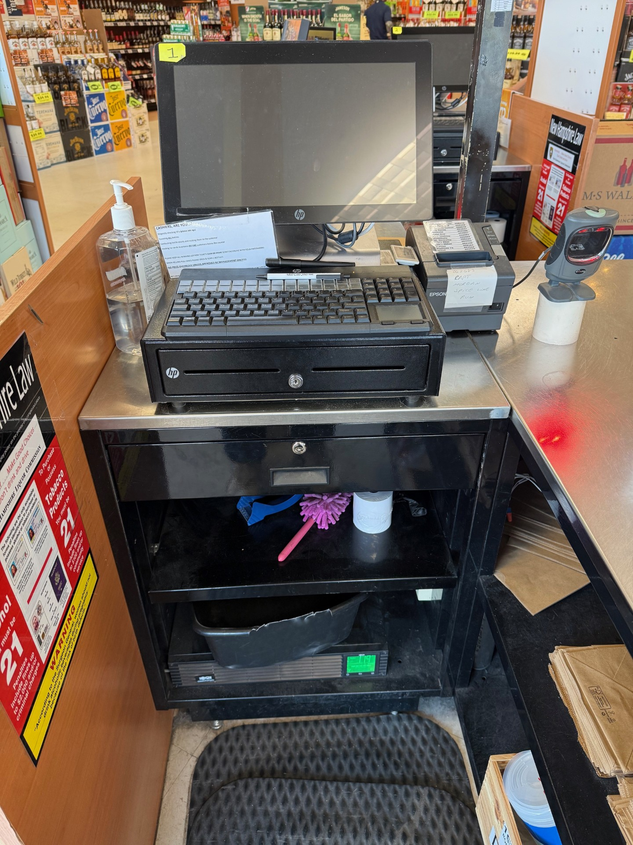
Typical Lane 1

Slide 15
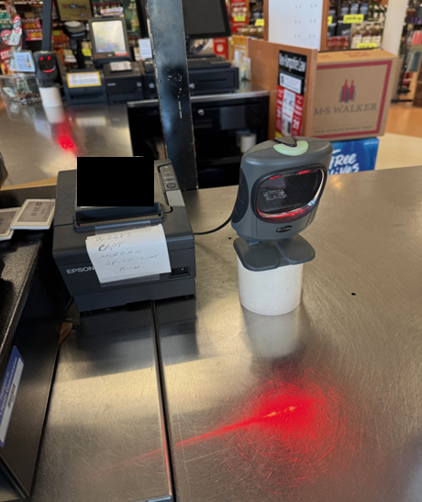
Retail Locations IT Environment

Slide 16
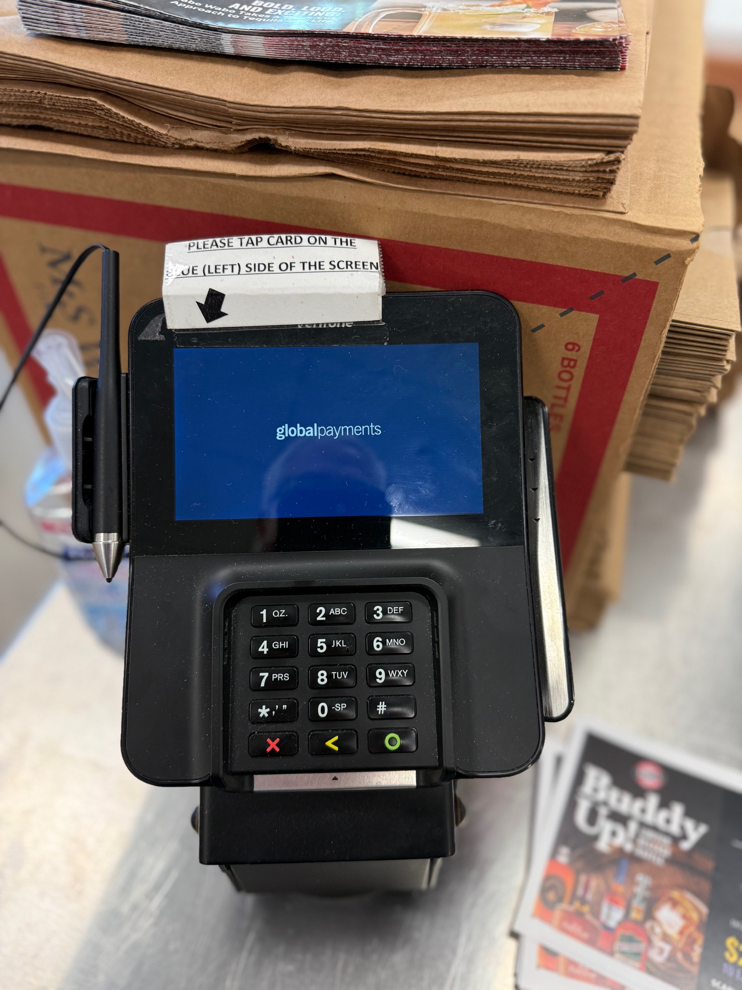
Retail Location IT Environment

Slide 17
Retail Location IT Environment
Manager’s Office
PC model (Monitor, keyboard and mouse) (1-3 per store)
Dell 5050 MFF
Dell 7020 MFF
HP LaserJet Pro MFP M428FDN Network Printer
Samsung A9+ Tablets (2-4 per store)
Cisco IP Phone 8861 “Office Phone”
HP LaserJet Pro M404dw Wireless printer
Epson TM-T88VII Wireless receipt printer
Includes Epson OT-WL06
IoT Device – Order Indicator Light “Curbside Pickup Light”

Slide 18
Retail Location IT Environment
Manager’s Office (continued)
Inventory Scanners
Zebra TC21 inventory scanners (2-10 per store)
Zebra 5-bay cradle (1-2 per store)
Zebra CRD-TC2Y-BS5CO-01
Zebra PWR-BGA12V108W0WW
Zebra CBL-DC-381A1-01
Zebra 23844-00-00R
Network Equipment
Cisco Router
Cisco Switch
Network UPS’s
APC SMT3000
APC SMX3000LV

Slide 19
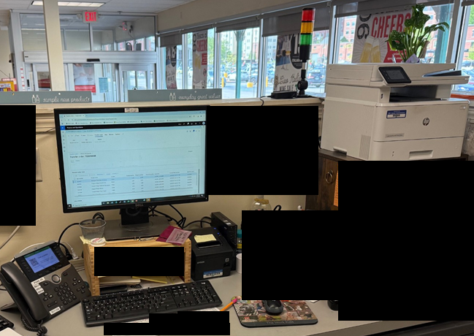
Typical Manager’s Office

Slide 20
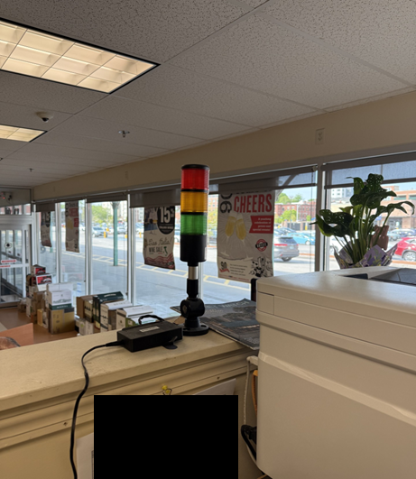
Orders Pending IOT light

Slide 21
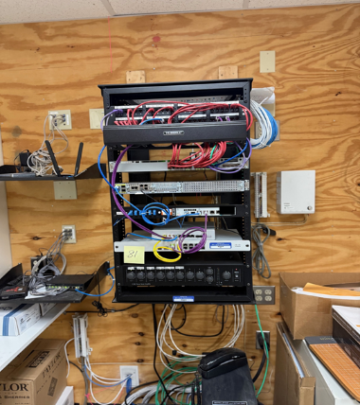
Typical Network Rack

Slide 22
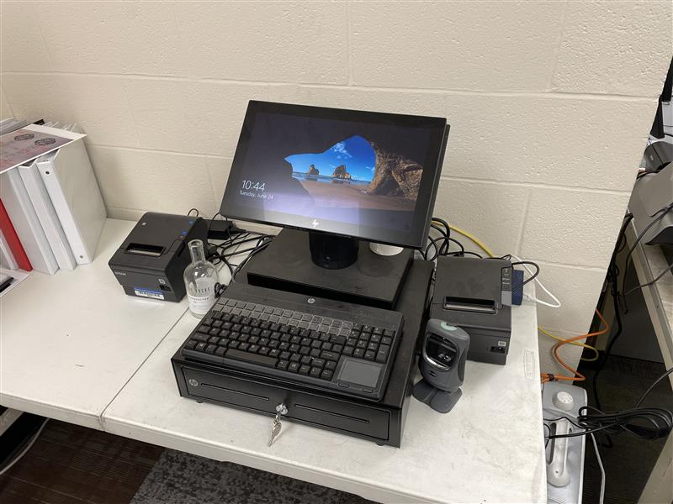
Retail Location IT Environment
Training/Testing Lane
Training and testing lanes will have the same equipment as retail lanes, but will be the first site for testing on any new models of equipment that is being considered for implementation into the NHLC environment

Slide 23
2024 Help Desk Tickets

Slide 24
2024 Help Desk Tickets
295 Help Desk Calls in 2024 Required on site response
82 – POS Lane Equipment
69 - Merchant Card Terminal
45 – UPS
32 – Manager’s Office Equipment
30 – Printers
28 – Scanners
5 – Miscellaneous
2 – Phone
1 - Tablet
1 – Training Lane

Slide 25
Key parts of the RFP and Response

Slide 26
Collaboration
It is critical that the selected vendor of this procurement understand that collaboration and ownership are critical to the success of this engagement.
NextGen is a multi – entity environment
All parties must be engaged in the resolution of any system anomalies, regardless of who’s primary area of responsibility the anomaly occurs in, until the event is resolved.
Partnership
Contract duration is 5 years with possible extensions for up to 4 more years.

Slide 27
Communication
Communications skills are critical for all vendor staff
Field staff must:
Contact Liquor Help Desk to notify store of visit
Contact Store management upon arrival and prior to departure
Sign into visitor logs for each visit and IT closet log if necessary
Field staff are required to provide employer credentials to verify identity
NHLC Help Desk must be kept up to date with progress
NHLC equipment with value over $250 is asset tagged and must be accounted for

Slide 28
Priorities
The number one priority is to keep stores Operational
Loss of a lane at a two-lane store is different than loss of a lane at an 8-lane store
RFP outlines general priorities
Calendar plays an important role in priorities
NHLC Help Desk has final say on priorities
Vendor staff must have consistent and effective communication with the NHLC Help Desk!!!!

Slide 29
Repair & Replacement
Vendor’s proposal must clearly define their ability to repair equipment
Replace and Repair later is an option to limit store down time
Most equipment categories will have replacements available at NHLC HQ or selected depot locations

Slide 30
Troubleshooting
Solid troubleshooting skills are a must for all staff
Consistent methodology is critical
Vendor provided equipment for testing must be available to field staff

Slide 31
Support Model
NHLC HQ works Mon – Fri 7:30 AM to 4:30 PM
Outlets open 7 days per week 8:00 AM to 10:00 PM
Only closed on Thanksgiving, Christmas and Easter

Slide 32
Lane PC OS Image Management & Monthly Windows Patching
OS Image Management
Must coordinate to develop and maintain OS images
Multiple hardware lifecycles
Multiple images may be needed per hardware lifecycle
Monthly Golden configuration “GOLD image”:
Windows, anti-virus, remote agent updates required
Duplicated, copies are provided to technicians and NHLC/DoIT staff
Technicians must be held accountable for their copies: securing, reporting lost/stolen, and surrendering upon termination
Windows Patching
Must coordinate to develop a cadence for Windows patches
Schedule shall be approved by the NHLC, accounting for delays due to project deployments and holidays
Patching level expected to be 100% for current group within 24hrs
NHLC Remote Monitoring and Management (RMM) solution used

Slide 33
Important Procedural Items

Slide 34
Procedural Items
Submission Deadline – August 6, 2025 2:00 PM EDT
No Exceptions
Late items will not be reviewed
Terms and conditions are not negotiable at Contract time
Raise any issues and provide proposed language during the question period
Cost Proposal
Must be separate from technical proposal
Governor and Council

Slide 35
Procedural Items
Oral Interviews
Corporate representative
NHLC selected Candidates for
Team Lead/Project Manager
Field Technician

Slide 36
Procedural Items
Communications
All communication from vendors to the State of NH regarding the RFP need to be directed to the issuing officer, Janet Donnelly and not directed to other State employees.
Janet.M.Donnelly@Liquor.nh.gov
RFP Updates or Amendments
Vendors must check the NHLC website for updates
gov.liquorandwineoutlets.com
About
Public Notices

Slide 37
Questions?

Slide 38
Questions?
Today’s answers are preliminary and will be formalized in an amendment document that will be posted on the website.

Slide 39
Conclusion
Thank you for your participation
Remember:
Questions due by July 16, 2025 (earlier the better)
Terms and Conditions Not negotiable after proposal submission
Pricing information should be separate
Submission deadline August 6, 2025 at 2:00 PM EDT

